Slide 1
out_Veggin
Term 2 Assignment 2 - Rails App
Notes:
Hello all hope your all well...so here is the presentation that i created for the application out_veggin....so far…. so welcome to my masterpiece.. Out_veggin. ..

Slide 2

Mission statement: Every-one should be able to earn an income or(side).
Notes:
So, the reason i created this application is because of the many people in this world that cant work for any reason, stay at home parents, disabled people , carers, etc, the list goes on. And have a green thumb like me, and would like to make a side income.
I feel its the perfect opportunity to give back to the community also, you can do weekly deals or packs of vegetables to create recipes. As a buyer, you know your helping your neighbours get along, and buying locally is good also, you know how fresh your items are and exactly where they are coming from.

Slide 3
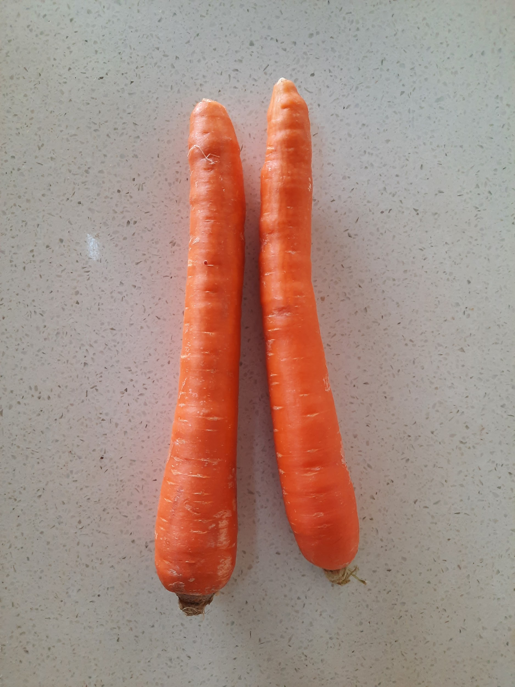

The problem
Many people out there love to grow there fruit and vegetables - but they need to pay for expensive stalls, and can’t transport.
Notes:
Basically the problem is, many people cant physically get the money to go and buy a pop up spot at a market. And if they can, trying to transport all there fruit and vegetables is a nightmare, trying to keep it fresh and if they dont sell it, they have to either give it away or throw it out!
So this app in essence links the product straight to the consumer and doesnt have to undergo long transports and huge weight times from mass picking where its stored in containers for where it loses nutrients.
Thats one of my pictures of carrots at the top if your all wandering what that is.

Slide 4

The solution
So bring in out_Veggin!
Easy to use - basic setup with user logins.
Notes:
So yep as it says bring in out_veggin! My application. It will solve all these problems, by being so simple and efficient, you can setup an account and be buying or selling your local and fresh items in no time.

Slide 5
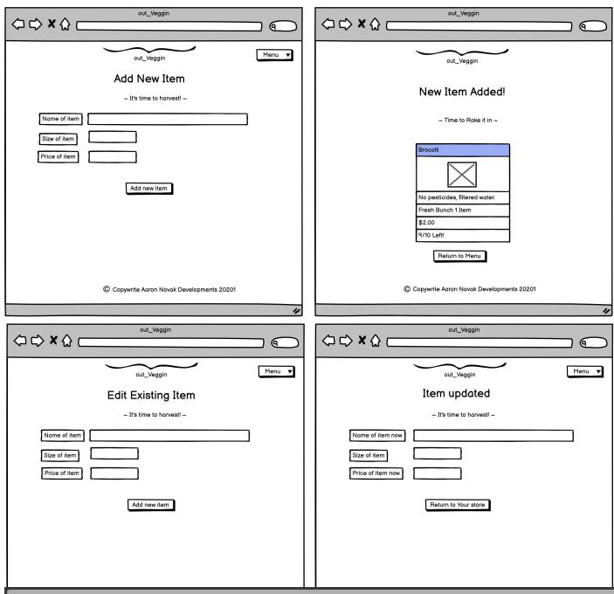
Some Wireframes
Notes:
Here are some of the wireframes I came up with . My current site doesnt look like this yet, its much harder then it seems to make it look like this.

Slide 6
How it works
Step 3
Step 2
Step 1
Select item, Buy! Or
Add item, click Sell!
Login as buy/seller
Create Account
Notes:
As stated earlier its extremely basic and easy to use, create your account, you are either a buyer or a seller. Then you can search an item to buy, or add and item to sell. If you are the seller you can Edit existing items, or delete it with a click of a button!
If your the buyer, it has an easy system where it will eventually have an online messaging system , like a chat field so that you can directly talk to the supplier and you can tee up a time and place to get the items. Im going to try and put a trade items in there, so if you have a massive lemon tree but you really need tomatoes for that dish asap, you can offer to trade your lemons for their tomatoes!

Slide 7

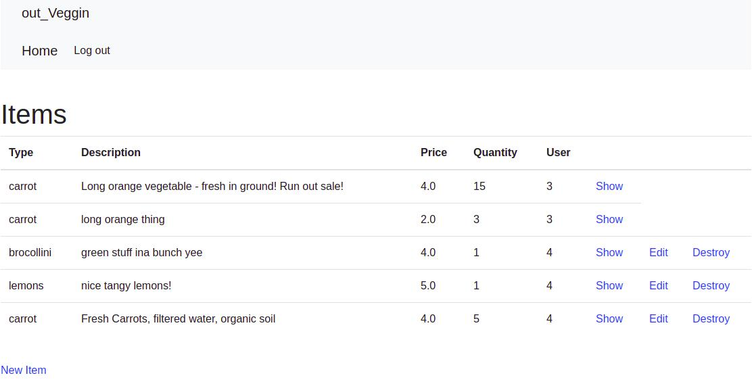
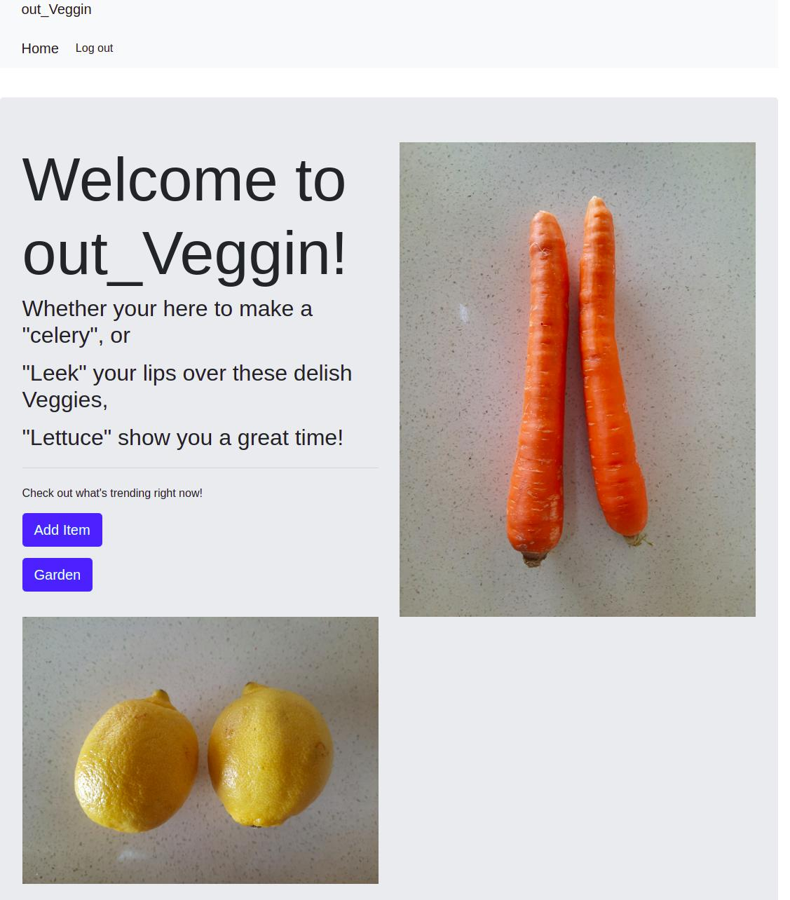
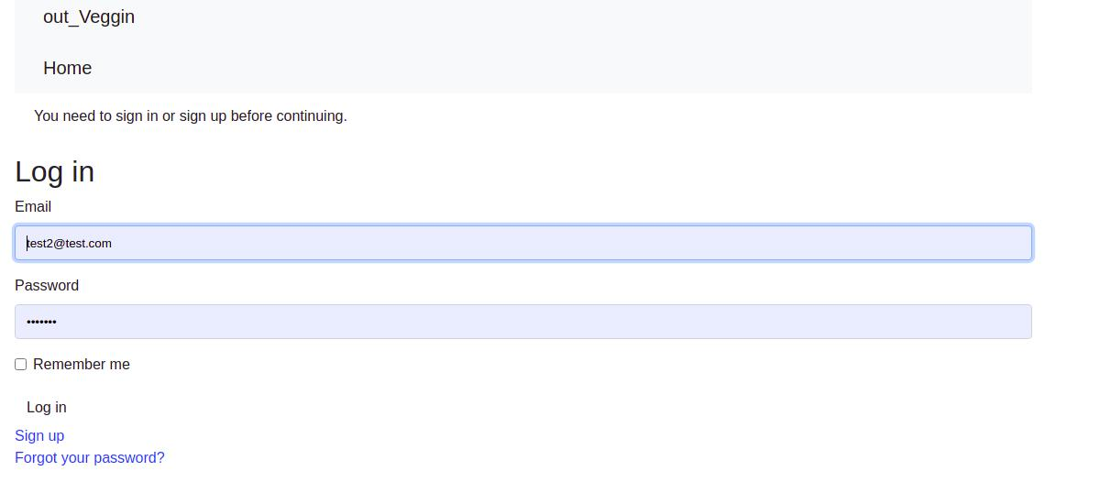
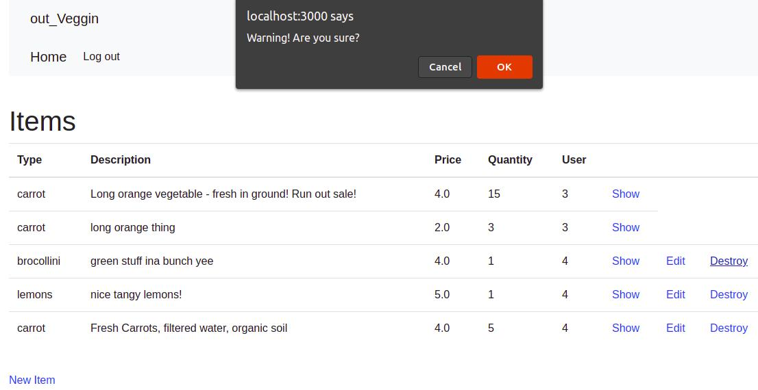
Screenshots
So here are some screenshots of it working!
Notes:
Yes there very tiny, there not much to look at, if i get some time id love to style it all but for now its a full system that has CRUD, authentication and authorisation. Its basically the same as every one elses login screens from standard devise installations so I wont bother impressing every one with that, weve seen a fair few of them today

Slide 8

The tech stack:
Rails, HTML/CSS, Bootstrap, JS, Postgresql,
Notes:
My tech stack is fairly simple, i used rails to create the main part of the application, used the generate framework rails command to create most of it. The rest will eventually be styled using more bootstrap, I ran out of time for styling so this is all I could come up with in the time.
I used postgres of course as the DB , and used a few gems like devise and rolify to create the autorisation and authentication.
Also used the Trello board as a means to do my project development.

Slide 9
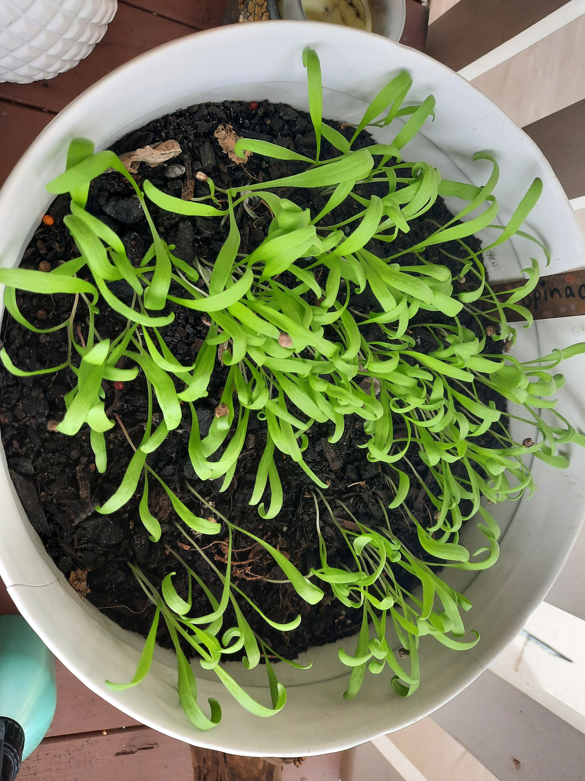
Future Developments
Styling
APIS - postage
Messaging System
Here are some of the future developments that will be implemented.
Notes:
As you can tell from the really awesome styling on the other page, it probably needs a lot more, I do really want to keep it fairly basic though, I want it keep it easy to use so even someone that hasnt used a mobile phone that much can find it easy to learn and read.I really wanted to get stripe to work at a minimum but i ram running out of time. I am interested in the XYZ API though, which would make it so much easier with a few clicks to login through a social media account, as most people have them, people I know that dont even know how to use google really have them setup for them, for example, my father.
There will be filtering implemented so that it goes straight to the correct item you would like, I really dont want it it have too much background algorithms, I myself am over searching certain 2 way market place apps and being inundated with non searched items to sway me into buying things I dont want.
Id would also like to incorporate a buying packs system, for example, a person will grow all the items that they put into there own home made dishes and they can sell as packs, and who knows maybe they can be on their way to making a recipe thats sold world wide, like the big chefs! I know my grandma used to make the best croatian and hungarian foods, and now shes gone, no one can replicate even close to how she would make it

Slide 10
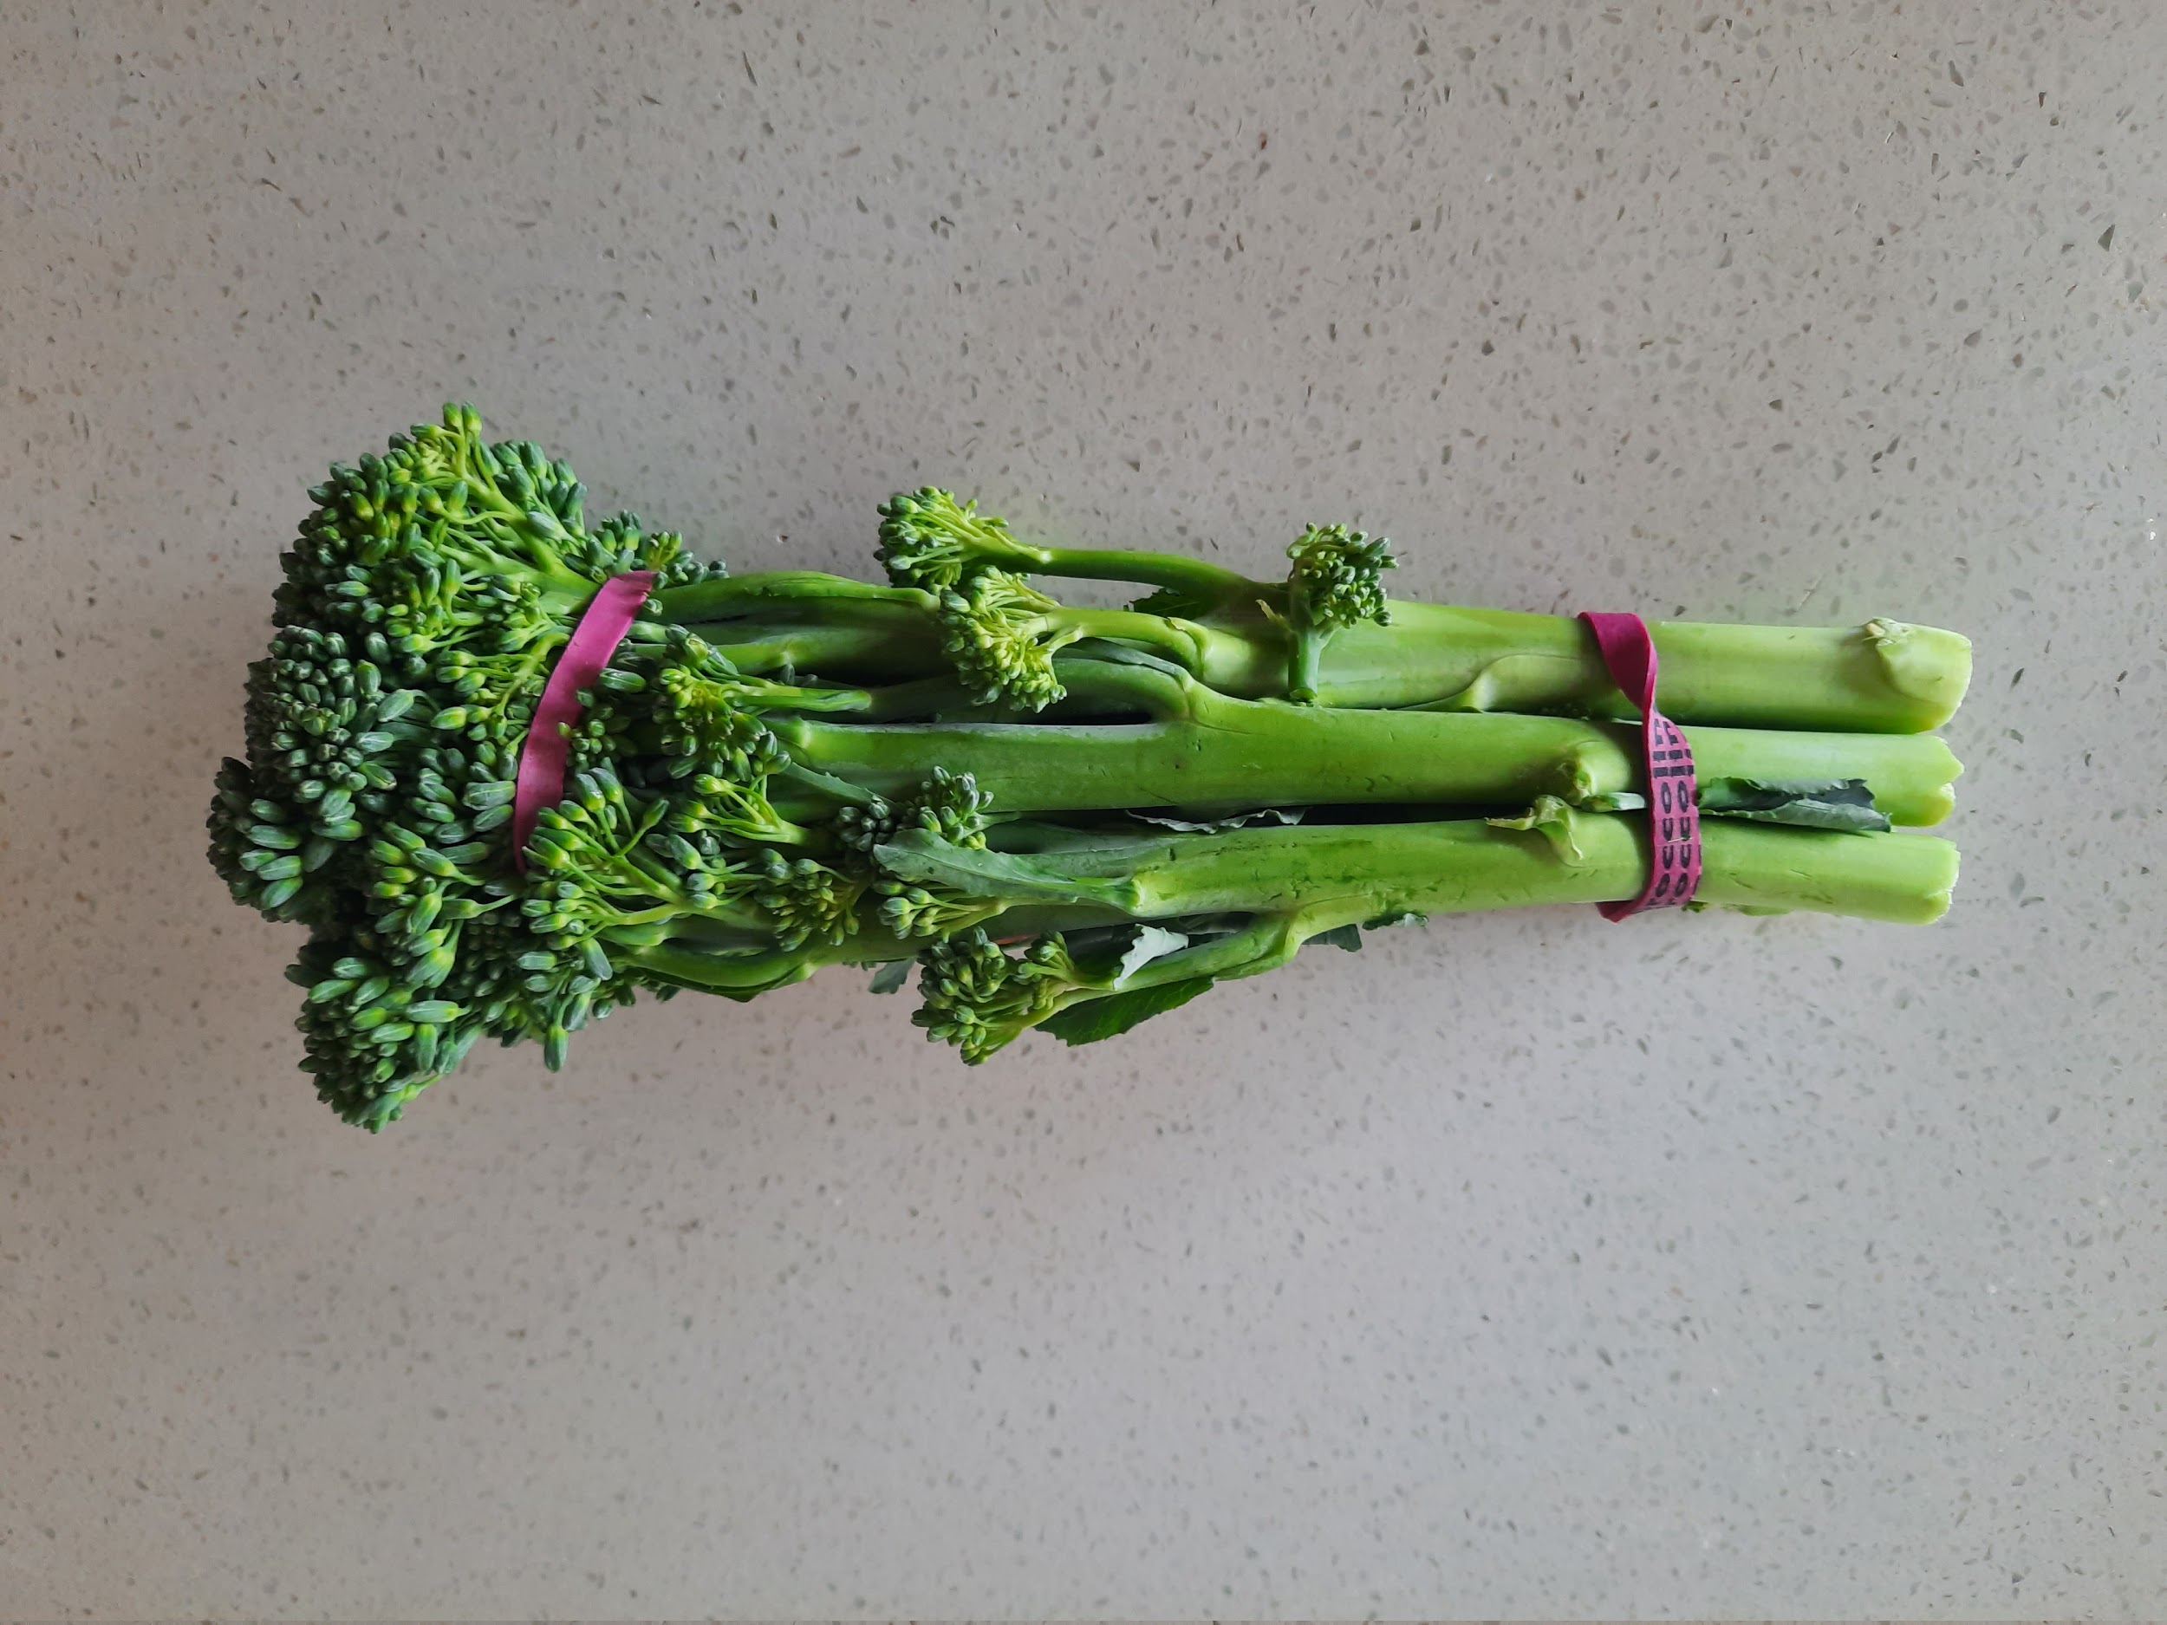
Problems
I have run into many….
Here are ‘some’...
Styling
Getting the basics to work
CRUD troubles - MVC messed up
API’s
Gem’s
MANY MORE...
Notes:
Basically most of my time I wasted was on styling of course, had I of just created the standard application and not tried to pretty it up with things im not too familiar with firstly , I would of been much less stressed. I now understand how hard it would be to be a full stack developer, but its exactly what im going to be pushing towards, I do enjoy creating a whole application, the sense of accomplishment is well worth it, even in this current state.
I had troubles with my CRUD, i followed along a few of the tutorials, we all know which ones, and I tried to customise it with my own words, wow.that.was.silly! I accidentally kept using “Rails” saved words and didnt know why it wasnt working.
I wasted time trying to get API’s to work and many, many, many, gems, every day a new gem would appear before my very eyes, so id go down a rabbit hole trying to learn it and then fail and there goes a day, and id have to remove it because it wasnt for me or wasnt working how I wanted it.
I also learnt why other devs say they dont like the auto save on vs code as id change a few lines on a few different pages, it would all break and then im stuck for the whole day trying to work out what ive done wrong, instead of having auto save off, or even before trying to do something “out there”, do a git commit before I go all out on it and branch off.
Thank you all for your time.

